Slide 1
Utility Design Pattern
COMP 2601
Tyler, Tram, Tian, Chak Kwai, Jacob

Slide 2
Introduction
What is Utility Class?
The utility or helper pattern is useful to create a non-instantiable class
The methods declared in the class should all be static
Declaring a constructor as private and the class is abstract is the way to implement this pattern
Can mark the class as final
Benefits
When you don’t want to create an object
Use them internal in your own program
Keeping all sorts of unrelated methods in one place
Improve code quality, readability

Slide 3
Sample code
public abstract class NumberUtils {
private final static int EVEN_MODULOUS;
private final static int NOTHING_REMAINING;
static {
EVEN_MODULOUS = 2;
NOTHING_REMAINING = 0;
}
public static boolean evenNumber(Number x) {
return x.getNumber() % EVEN_MODULOUS == NOTHING_REMAINING;
}
}
public class Number {
private final int number;
public Number(final int number) {
this.number = number;
}
public int getNumber() {
return number;
}
}

Slide 4
Utility Quiz Q&A
1. Why would we use a Utility design pattern? Give a real-life example.
Answer: Custom name or date formatter.
2. What are the important ingredients to implement a Utility class?
Answer: Abstract class or private constructor, static methods. It ensures no object is created and only static methods are used by callers.

Slide 5
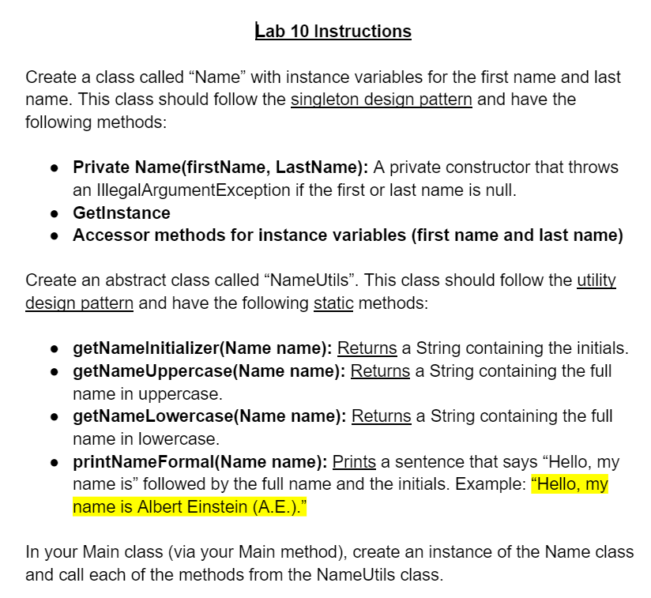

Slide 6
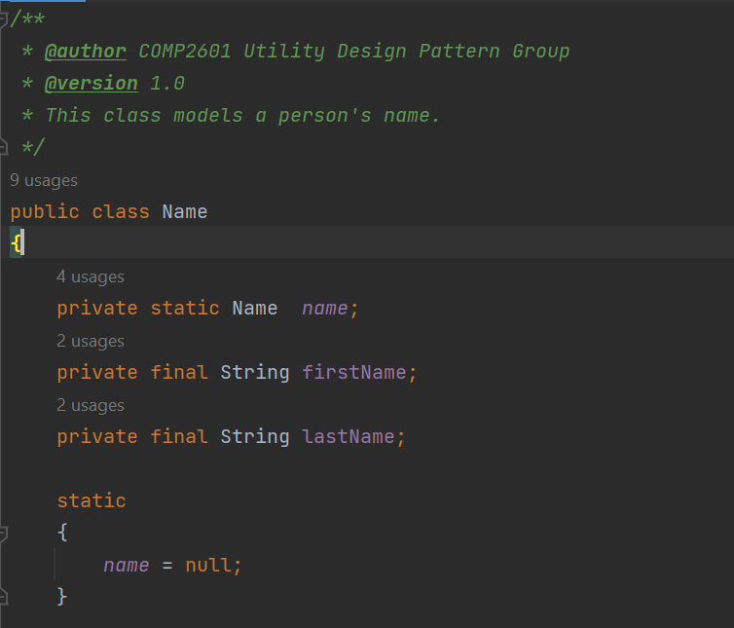
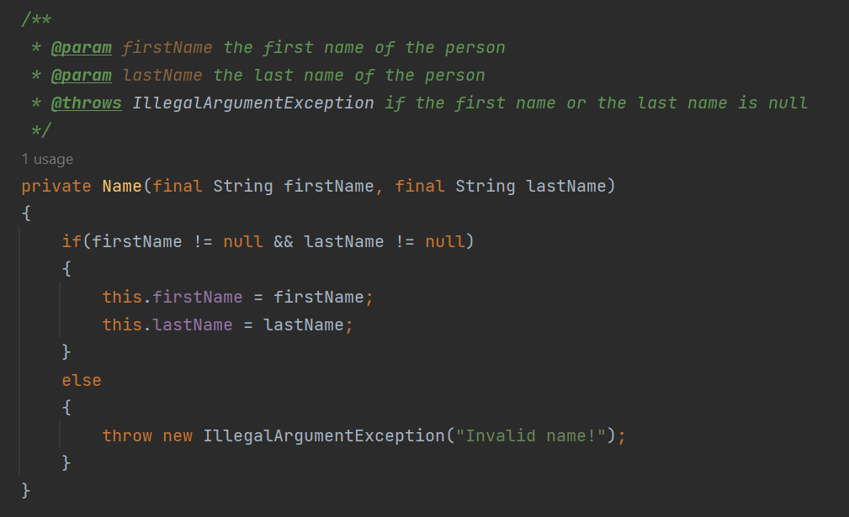
Lab Sample solution - Name class
**private constructor**

Slide 7
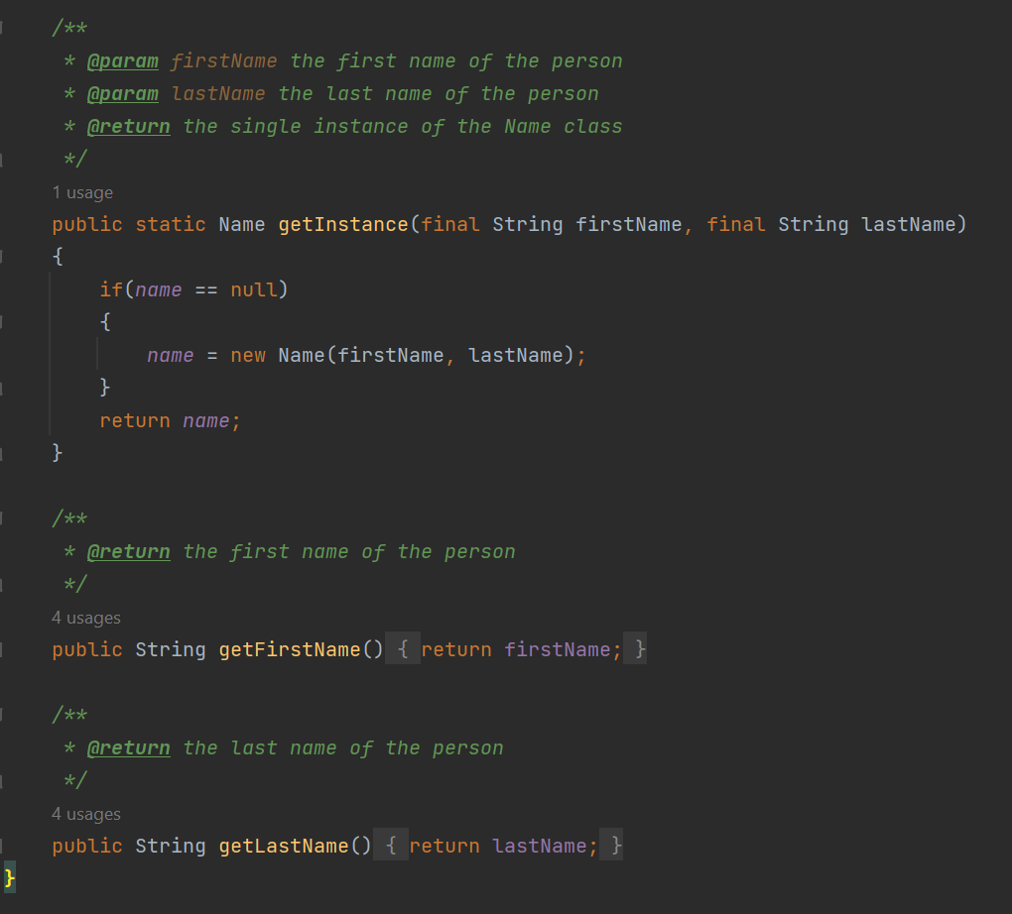
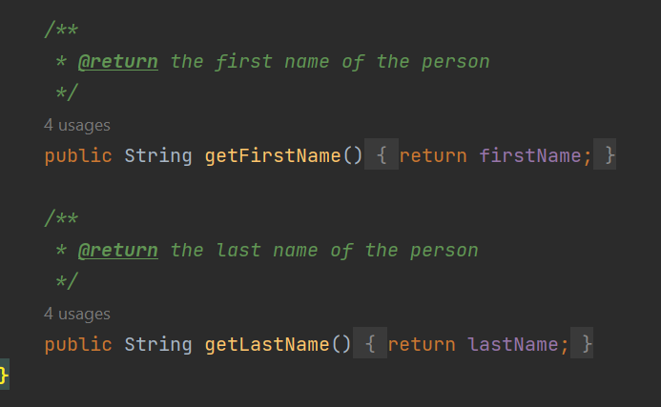
Lab Sample solution - Name class
Implement Singleton design pattern

Slide 8
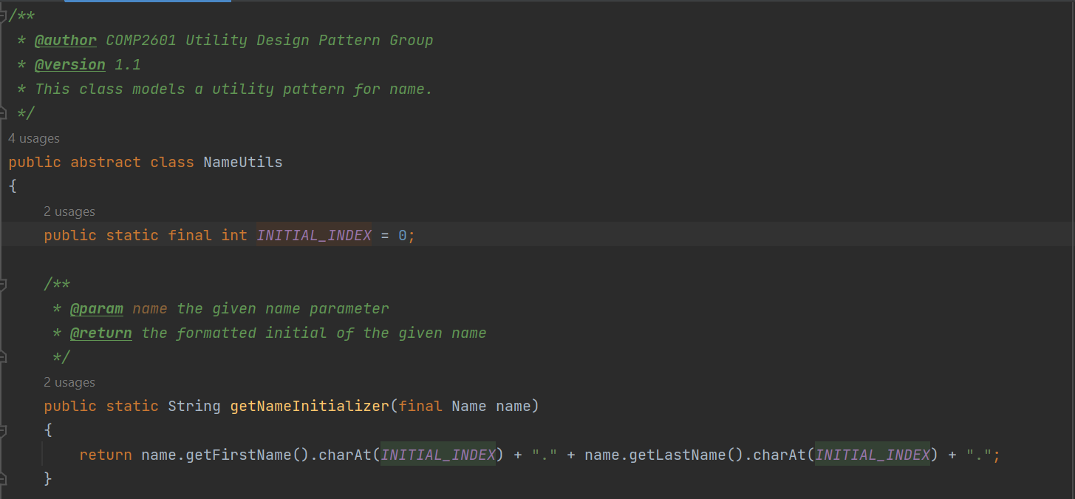
Lab Sample solution - NameUtils class
Implement Singleton design pattern
**Abstract class**

Slide 9
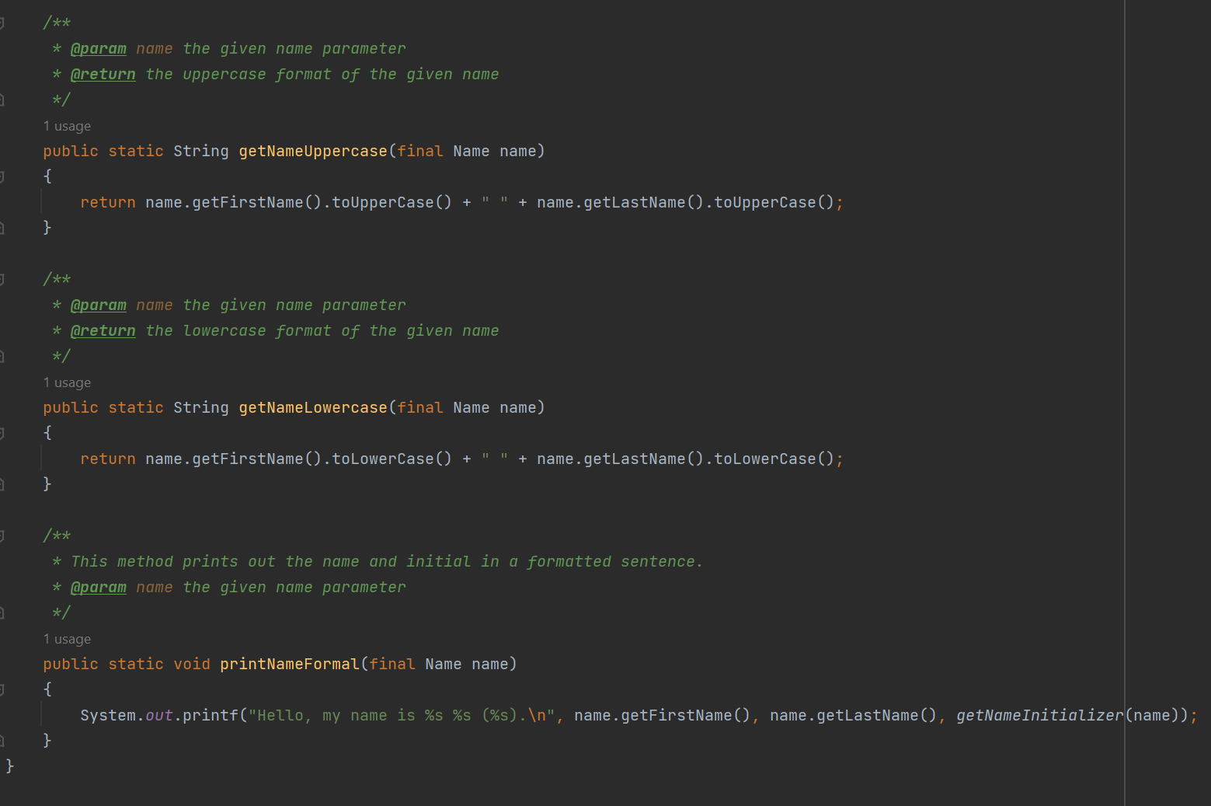
Lab Sample solution - NameUtils class
**Static methods**

Slide 10
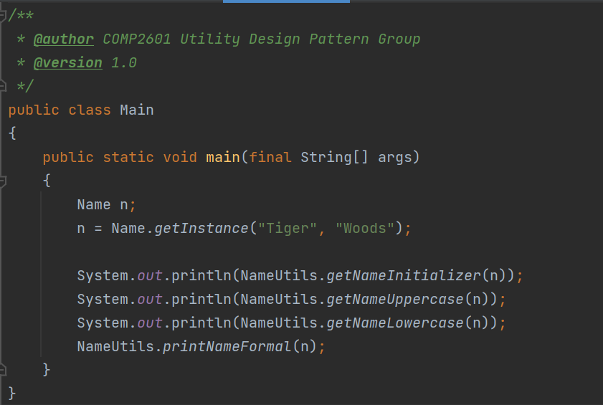
Lab Sample solution - Main class

Slide 11
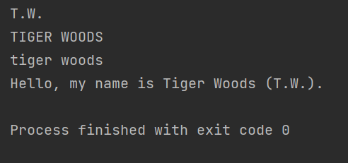
Lab Sample solution - Output

Slide 12
Thank You!

